Slide 1
JDBC - ODBC
Typically, software applications are written in a specific programming language (such as
Java, C#, etc.)
while databases accept queries in some other database specific language (such as SQL).
Therefore, when a software application needs to access data in a database, application
programmers need to learn and incorporate database specific languages within their
applications.
ODBC (Open Database Connectivity) and JDBC (Java DataBase Connectivity) are two
API (application program interface ) that solve this specific problem.
They are interfaces that can translate languages to each other (application and database)
ODBC and JDBC achieve portability. All direct interaction with a specific DBMS
happens through a DBMS specific driver. A driver is a software program that translates
the ODBC or JDBC calls into DBMS specific calls.

Slide 2
Database Connectivity History
Before APIs like JDBC and ODBC, database connectivity was tedious
Each database vendor provided a function library for accessing their database
The connectivity library was proprietary.
If the database vendor changed for the application, the data access portions had to be rewritten
If the application was poorly structured, rewriting its data access might involve rewriting the majority of the application
The costs incurred generally meant that application developers were stuck with a particular database product for a given application
The major difference between embedded SQL and JDBC or ODBC is :
The pre-processor replaces embedded SQL requests with host-language declarations and procedure calls, then the resulting program is compiled by the host-language compiler
In JDBC, even the SQL statements are interpreted at runtime ( even if they are prepared first using the prepared statement feature).

Slide 3
JDBC - ODBC
ODBC is an interface that does not depend on a specific programming language or a database system or an operating system. It can be used to write applications that can query data from any database, regardless of the environment it is running on or the type of DBMS it uses.
Major advantage of having ODBC as a universal middleware between an application and a database is that every time the database specification changes, the software does not need to be updated. Only an update to the ODBC driver would be sufficient. Most commonly used with C, C++,C#, VB
JDBC is a data API for the Java programming language. It is an interface that helps a client to access a database system, by providing methods to query and update data in the databases. JDBC is more suitable for object oriented databases.
The application connections to the database server establishing a session; executes a series of statements; and finally disconnects the session.
The point that fundamentally differentiates JDBC and ODBC is that JDBC is language dependent and it is Java specific whereas, the ODBC is a language independent.

Slide 4
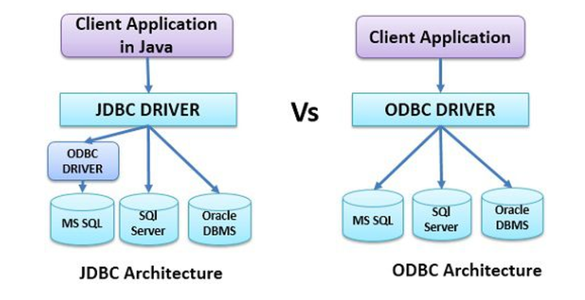
JDBC - ODBC
Java programmers can use JDBC-to-ODBC bridge to talk to any ODBC compliant database.

Slide 5
What is JDBC?
JDBC provides Java applications with access to most database systems via SQL
The architecture and API closely resemble Microsoft's ODBC
JDBC 1.0 was originally introduced into Java 1.1
JDBC 2.0 was added to Java 1.2
JDBC is based on SQL-92
JDBC classes are contained within the java.sql package
It has a combination of classes and interfaces which contain methods for:
Connecting to a remote database
Executing SQL statements
Transaction management and Exception Handing

Slide 6
JDBC Architecture
With JDBC, the application programmer uses the JDBC API
Any proprietary APIs are implemented by a JDBC driver
There are 4 types of JDBC Drivers
Java Application
JDBC API
JDBC DriverManager
JDBC Driver
JDBC Driver

Slide 7
JDBC Drivers
There are 4 types of JDBC Drivers
Type 1 - JDBC-ODBC Bridge
Type 2 - JDBC-Native Bridge
Type 3 - JDBC-Net Bridge
Type 4 - Direct JDBC Driver
Type 1 only runs on platforms where ODBC is available
ODBC must be configured separately
Type 2 Drivers map between a proprietary Database API and the JDBC API
Type 3 Drivers are used with middleware products
Type 4 Drivers are written in Java
In most cases, type 4 drivers are preferred
For your project you will use Type 4 driver.
Download the driver software ojdbc6 jar file to
C:\Program Files (x86)\Java\jre1.8.0_121\lib\ext

Slide 8
JDBC Classes
DriverManager
Manages JDBC Drivers
Used to Obtain a connection to a Database
Types
Defines constants which identify SQL types
Date
Used to Map between java.util.Date and the SQL DATE type
Time
Used to Map between java.util.Date and the SQL TIME type
TimeStamp
Used to Map between java.util.Date and the SQL TIMESTAMP type

Slide 9
JDBC Interfaces
Driver
All JDBC Drivers must implement the Driver interface. Used to obtain a connection to a specific database type
Connection
Represents a connection to a specific database
Used for creating statements
Used for managing database transactions
Used for accessing stored procedures
Used for creating callable statements
Statement
Used for executing SQL statements against the database

Slide 10
JDBC Interfaces
ResultSet
Represents the result of an SQL statement
Provides methods for navigating through the resulting data
PreparedStatement
An SQL statement (which can contain parameters) is compiled and stored in the database
CallableStatement
Used for executing stored procedures
DatabaseMetaData
Provides access to a database's system catalogue

Slide 11
Using JDBC
To execute a statement against a database, the following flow is observed
Load the driver (Only performed once)
Obtain a Connection to the database (Save for later use)
Obtain a Statement object from the Connection
Use the Statement object to execute SQL. Updates, inserts and deletes return Boolean. Selects return a ResultSet
Navigate ResultSet, using data as required
Close ResultSet
Close Statement
Do NOT close the connection
The same connection object can be used to create further statements
A Connection may only have one active Statement at a time. Do not forget to close the statement when it is no longer needed.
Close the connection when you no longer need to access the database

Slide 12
Loading Drivers
When a JDBC Driver class is loaded, it must create an instance of itself and register that
instance with the JDBC DriverManager class.
How does one load a "class" into the Virtual machine?
Use the static method Class.forName( )
Class.forName("oracle.jdbc.driver.OracleDriver");
// or Class.forName("oracle.jdbc.OracleDriver");

Slide 13
Connecting to a Database
Once a Driver is loaded, a connection can be made to the database
The connection is specified through a JDBC URL
The URL has the following form:
jdbc:<subprotocol>:<databasename>:<otherParameters>
Overloaded versions of the getConnection method allow the specification of
username and password for authentication with the database
A connection is obtained in the following manner:
Syntax : Connection obj = DriverManager.getConnection(URL,userId,pwd);
Connection conn = DriverManager.getConnection( "jdbc:oracle:thin:@localhost:1521:xe",“leela",“vasavi");
.

Slide 14
Using a Connection
The methods provided by Connection for managing and using a connection to the database
public Statement createStatement()
public PreparedStatement prepareStatement(String sql)
public void setAutoCommit(boolean)
public void commit()
public void rollback()
public void close()
The most commonly used method is createStatement( )
When an SQL statement is to be issued against the database, a Statement object must be created through the Connection

Slide 15
Using a Statement
The Statement interface defines two methods for executing SQL against the database
public ResultSet executeQuery(String sql)
public int executeUpdate(String sql)
executeQuery returns a ResultSet
All rows and columns which match the query are contained within the ResultSet
The developer navigates through the ResultSet and uses the data as required.
executeUpdate returns the number of rows changed by the update statement
This is used for insert statements, update statements and delete statements

Slide 16
Using a ResultSet
The ResultSet interface defines many navigation methods
public boolean first()
public boolean last()
public boolean next()
public boolean previous()
public boolean absolute(int row)-- Moves the cursor to the given row - number in this ResultSet object.
public boolean relative(int rows) -- Moves the cursor a relative number of rows,either positive or negative
public void close()
The ResultSet interface also defines data access methods
public int getInt(int columnNumber) -- Note: Columns are numbered
public int getInt(String columnName) -- from 1 (not 0)
public long getLong(int columnNumber)
public long getLong(String columnName)
public String getString(int columnNumber)
public String getString(String columnName)
There are many more methods. Check the API documentation for a complete list

Slide 17
SQL Types/Java Types Mapping
SQL Type Java Type ResultSet get method
CHAR String getString()
VARCHAR String getString()
BIT Boolean getBoolean()
INTEGER Integer getInt()
REAL Double getDouble()
FLOAT Float getFloat()
DOUBLE Double getDouble()
DATE java.sql.Date getDate()
TIME java.sql.Time getTime()
TIMESTAMP java.sql.Timestamp getTimestamp()

Slide 18
Example Code:
import java.sql.*;
import java.util.Properties;
class OracleCon
{
public static void main(String args[])
{
try
{
//step1 load the driver class
Class.forName("oracle.jdbc.driver.OracleDriver”);
//step2 create the connection object
Connection con=DriverManager.getConnection(
"jdbc:oracle:thin:@localhost:1521:xe","leela",“vasavi");
//step3 create the statement object
Statement stmt=con.createStatement();

Slide 19
Example Code (continued):
//step4 execute query
ResultSet rs = stmt.executeQuery("select * from sailors");
while(rs.next())
System.out.println(rs.getInt(1)+" "+rs.getString(2)+" "+rs.getString(3));
//step5 close the connection object
con.close();
}
catch(Exception e)
{
System.out.println(e);
}
}
}

Slide 20
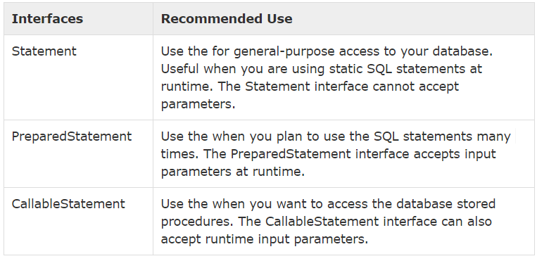
Using a Statement

Slide 21
Exceptions and Warnings
Most of the methods in java.sql can throw an Exception of the type “SQLException” if an exception occurs. The information includes SQLSTATE, a string that describes the error.
SQLException has the methods:
getMessage() : standard method inherited from Throwable
public String getSQLState() : returns an SQLSTATE identifier
public int getErrorCode(): retrieves a vendor specific error code
public SQLException getNextException() : gets the next exception in the chain of exceptions associated with the current SQLException object.
SQLWarning is a subclass of SQLException. They are not thrown like other exceptions, they are not caught as a part of try-catch block. We need to specifically test whether warning exist.
Connection, Statement, and ResultSet objects all have a getWarnings() method with which we can retrieve warnings, if they exist.

Slide 22
Code Snippet: using PreparedStatement and executeUpdate()
1. String sql=“INSERT INTO Books VALUES (?,?,?,?,0,?,?)”;
PreparedStatement stmt= con.prepareStatement(sql);
//now instantiate the parameters with values.
//Assume isbn, title, etc are java variables that contain the values to be inserte d
stmt.setString(1,isbn);
stmt.setString(2,title);
stmt.setString(3,author);
stmt.setFloat(4,price);
stmt.setString(6,publisher);
stmt.setInt(7,2017);
int numRows= stmt.executeUpdate();
2. String sqlQuery = “select * from Books”;
ResultSet rs = stmt.executeQuery(sqlQuery);
while(rs.next())
{
isbn = rs.getString(1);
title= rs.getString(“TITLE”);
. . .
}

Slide 23
JDBC Example-2 code
import java.sql.*;
. . .
public static void JDBCexample(String userid, String passwd)
{
try
{
Class.forName("oracle.jdbc.driver.OracleDriver");
Connection conn = Drivermanager.getConnection
("jdbc:oracle:thin:@db.yale.edu:1521:univdb",userid,passwd);
Statement stmt = conn.createStatement();
try
{
stmt.executeUpdate("INSERT INTO instructor VALUES ('7787','Kim','Physics',98000)");
}
catch(SQLException sqle)
{
System.out.println("Could not insert tuple"+sqle);
}

Slide 24
ResultSet rset = stmt.executeQuery(
“select dept_name, avg(salary)from instructor group by dept_name”);
while (rset.next())
{
System.out.println(rset.getString(“dept_name”) + “ ” + rset.getFloat(2)); }
}
catch(Exception sqlexp)
{
System.out.println("Exception:"+sqlexp);
}

Slide 25
ODBC
Open DataBase Connectivity (ODBC) standard :
Standard for application program to communicate with a database
Application program interface (API) to
Open a connection with a database
Send queries and updates
Get results back
Applications such as GUI, spreadsheets, etc. can use ODBC
Each database system supporting ODBC provides a “driver” library that must be linked with the client program
When client program makes an ODBC API call, the code in the library communicates with the server to carry out the requested action, and fetch results.

Slide 26
ODBC
ODBC defines the types HENV, HDBC, RETCODE and HSTMT
1. ODBC program first allocates an SQL environment, then a database connection handle
2. It then opens database connection using SQLConnect( )
Parameters for SQLConnect:
Connection handle
The server to which to connect
The user identifier, password
Must also specify types of arguments:
SQL_NTS denotes that argument is a null-terminated string

Slide 27
ODBC Code
int ODBCexample()
{
RETCODE error;
HENV env; /* environment */
HDBC conn; /* database connection */
SQLAllocEnv(&env);
SQLAllocConnect(env, &conn);
SQLConnect(conn,
"db.yale.edu", SQL_NTS, "leela", SQL_NTS, "vasavi", SQL_NTS);
{
code for the database transaction[slide #29]
}
SQLDisconnect(conn);
SQLFreeConnect(conn);
SQLFreeEnv(env);
}

Slide 28
ODBC
3. Once the connection is set up, the program sends SQL commands to the database by using SQLExecDirect
4. SQLBindCol() binds C language variables to attributes of the query result.
Arguments to SQLBindCol( ):
ODBC stmt variable, attribute position in query result
The type conversion from SQL to C
The address of the variable
For variable-length types like character arrays, the maximum length of the variable and
Location to store actual length when a tuple is fetched
5. Result tuples are fetched using SQLFetch( )

Slide 29
ODBC
Main body of program char deptname[80]; float salary; int lenOut1, lenOut2; HSTMT stmt;
char * sqlquery = “select dept_name, sum (salary) from instructor group by dept_name”;
SQLAllocStmt(conn, &stmt);
error = SQLExecDirect(stmt, sqlquery, SQL_NTS);
if (error == SQL_SUCCESS)
{ SQLBindCol(stmt, 1, SQL_C_CHAR, deptname, 80, &lenOut1); SQLBindCol(stmt, 2, SQL_C_FLOAT, &salary, 0 , &lenOut2);
while (SQLFetch(stmt) == SQL_SUCCESS)
{ printf (“ %s %g\n”, deptname, salary); } } SQLFreeStmt(stmt, SQL_DROP);

Slide 30
ODBC
By default, each SQL statement is treated as a separate transaction that is committed automatically
Can turn off automatic commit on a connection
SQLSetConnectOption(conn, SQL_AUTOCOMMIT, 0)
Transactions must then be committed or rolled back explicitly by
SQLTransact(conn, SQL_COMMIT) or
SQLTransact(conn, SQL_ROLLBACK)

